Slide 1
Magic Beans Demo Presentation
Alex Laurent, Nick Bolles, Topher Witt, Rich Sanchez

Slide 2
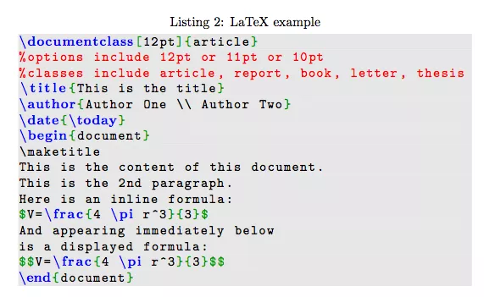
What is Latex?
Text editor for accurate editing of official documents
Uses code-like syntax for formatting

Slide 3

What is Magic Beans?
Magic Beans is a NetBeans plugin that allows users to edit Latex within NetBeans

Slide 4
How Does Magic Beans Work?
Connecting directly to Netbeans Architecture
Module Suite
Creating Latex project type
Jpanel pdf preview, syntax highlighting, tree navigation pane

Slide 5
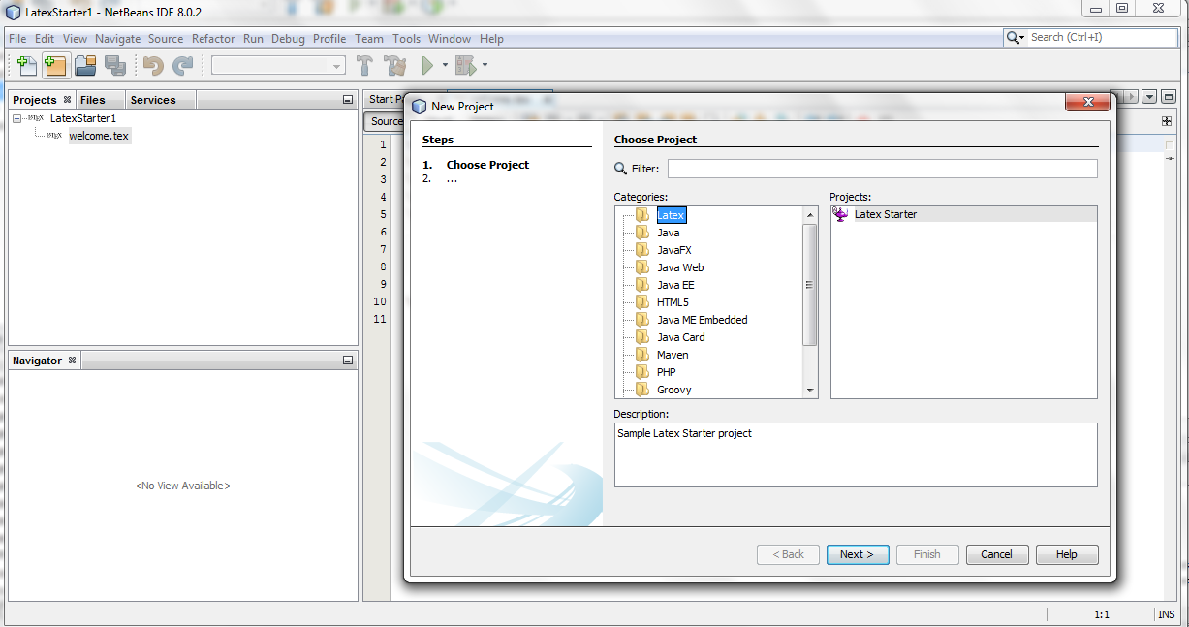
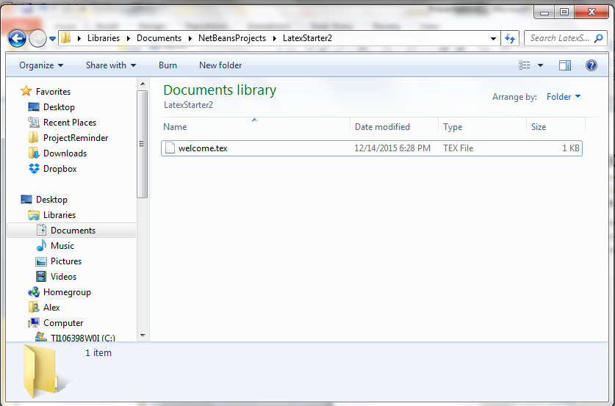
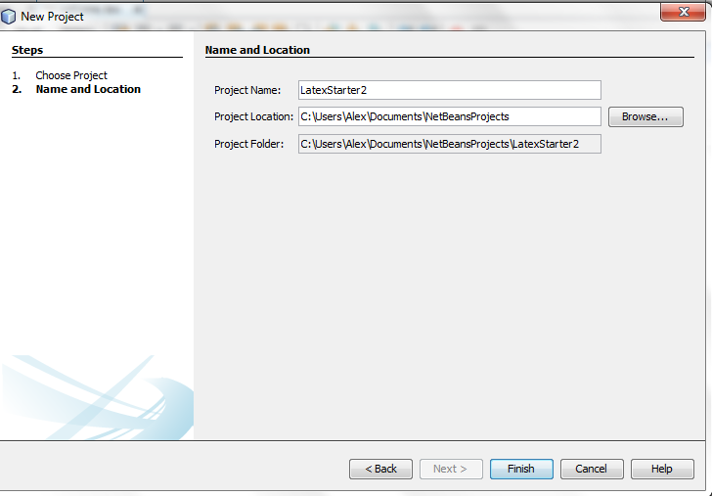
Screenshots

Slide 6
What Makes Us Different?
More directly integrated with NetBeans than any Latex NetBeans plugin
PDF preview in the same window and tab for side by side comparison
Project type capability

